Slide 1
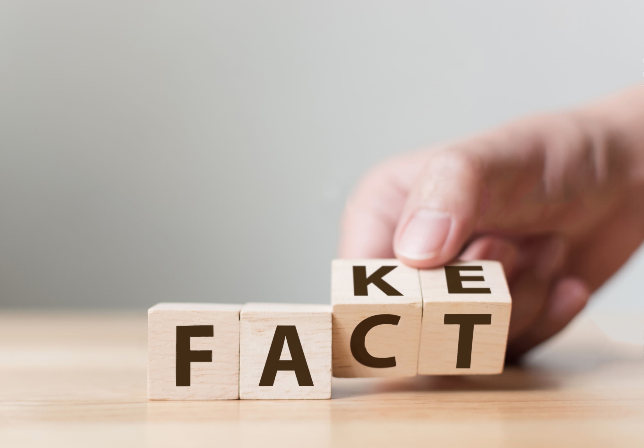

The Quest for Truth
Fact or Fiction?
Notes:
With our project we wanted to address a growing online issue, the quest for truth. With fake news taking over our news feed, how do we know what is fact and what is fiction?

Slide 2
The quest begins with
Notes:
The quest beings with Figgit.

Slide 3

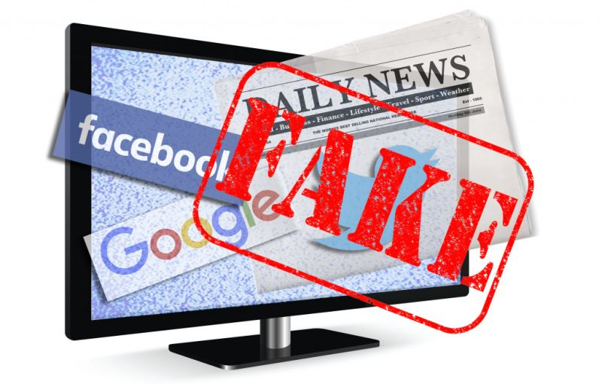

A Quest for the Truth
How do we research the news that we hear?
Where do we start?
How do we know we can trust the results we come up with to be unbiased and true?
Notes:
We live in an age where information is in overabundance. Everyday we are bombarded with news stories on social media, television, radio and our mobile devices. While many of these stories sound true, it’s important to research anything we decide to pass on or repost to avoid spreading false or misleading information. So how do we research the news that we hear? Where do we start and how do we know we can trust the results we come up with to be unbiased and true?

Slide 4
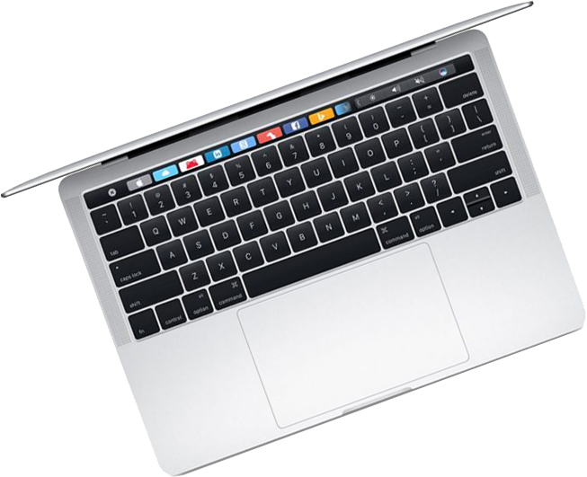
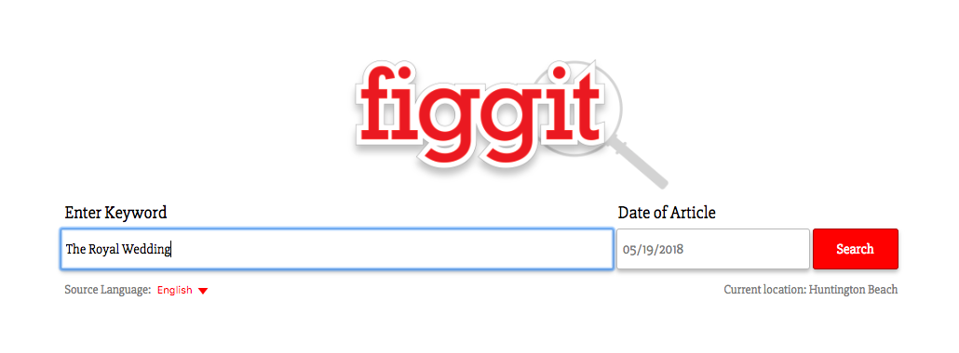

Comprehensive online search tool for news articles
Provides background information for news articles and their sources
Notes:
The Figgit app seeks to solve these dilemmas by providing a comprehensive online search tool that returns background information on news articles and their sources.

Slide 5
Returns relevant search results based on the user location and keyword data
Provides a simple rating system to help determine media bias
Notes:
A simple keyword search returns relevant news articles based on the users location and the keyword entered in the search bar. The results will provide source information for each article along with a media bias rating scale.

Slide 6
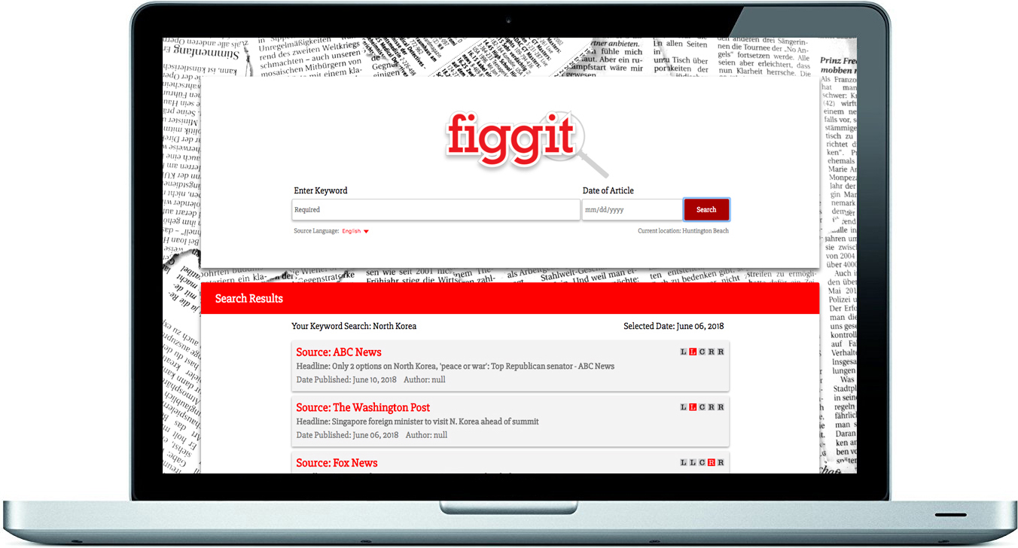

Notes:
Search results are sorted by (click) keyword relevancy and (click) the users location. This helps to narrow down the search results and return only the most relevant articles to the search.
Each search result contains the source, (click) headline, (click) publication date, (click) and author (click) of the article.
It also contains a (click) Bias Rating scale that illustrates the media bias commonly associated with that particular news source.
(click)

Slide 7





The Bias Rating
Liberal, Conservative or Neutral?
Extreme Left (Liberal) Views
Moderate Left (Liberal) Views
Centrist (Neutral) Views
Moderate Right (Conservative) Views
Extreme Right (Conservative) Views
Notes:
The Bias Rating is based on news source reporting and its tendency to publish stories with a liberal, conservative or neutral view. The rating is defined by a row of boxes, with the red box depicting views from left to right, the far left being the extreme left or liberal view and the far right being the extreme right or conservative view.

Slide 8
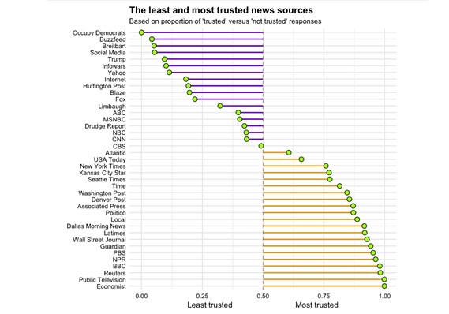
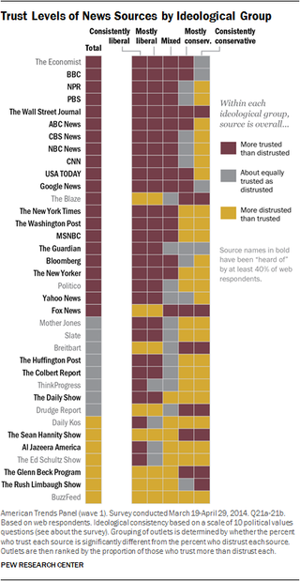


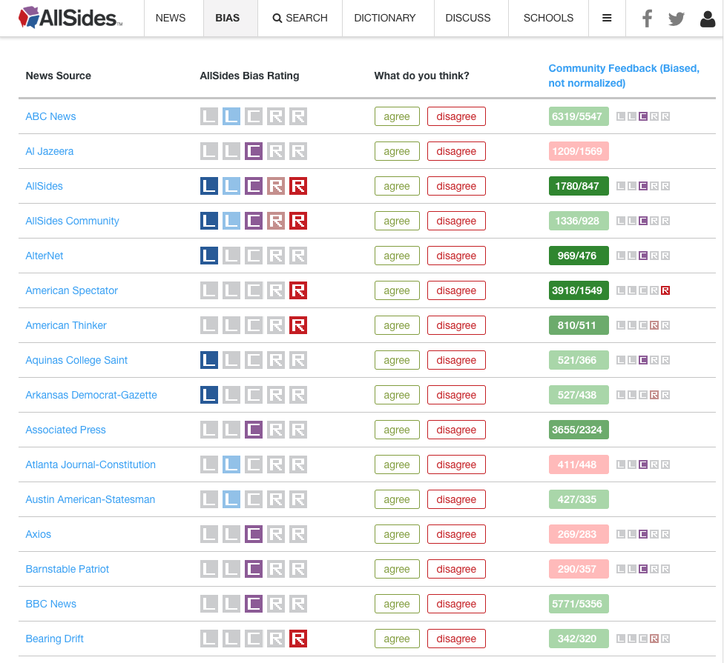
The Bias Rating
Liberal, Conservative or Neutral?
Extreme Left (Liberal) Views
Moderate Left (Liberal) Views
Centrist (Neutral) Views
Moderate Right (Conservative) Views
Extreme Right (Conservative) Views
Notes:
The ratings are based on data retrieved from various sources like (click)
Market Watch, (click) Business Insider (click) and AllSides.com, a website that collects community feedback to present a media bias rating for online news sources.
(click)

Slide 9
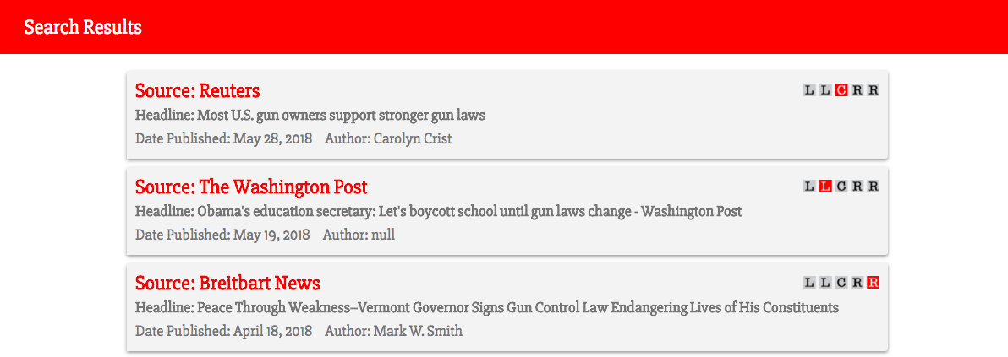
Alternate News Sources
Provides Perspective
Better Informed
Notes:
The purpose of the bias rating is not to tell the reader whether a story is accurate or fake news, but to provide the user with information that will give them perspective as to where the story originated while also providing additional stories on the same subject but from an (click) alternate source. It encourages the reader to view information from a (click) different perspective and, ultimately, be (click) better informed.
(click)
(click)

Slide 10
The Design Process
Brainstorm
Need Category
Purpose
Assign Tasks
UI Development
API Sourcing
Development
GitHub
Design
Name
Code Development
Research
News Sources
API Documentation
Browser Compatibility

Slide 11
Technologies Used and How They Work
HTML
CSS
Javascript
jQuery
API Server (NewsAPI.org)
AJAX
JSON
GitHub

Slide 12
Demo

Slide 13
Plans for Future Development

Slide 14
Let the quest begin.
Notes:
If knowledge is power, then research is the quest,
and Figgit is where that quest should begin.
Let the quest begin.

Slide 15
Let the quest begin.

